Slide 1
Sales/Customer Analytics
Retail Company

Slide 2
Objective
Problem Statement
Benefits
Sales management has gained importance to meet increasing competition and the need
for improved methods of distribution to reduce cost and to increase profits. Sales
management today is the most important function in a commercial and business
enterprise.
Analyze the sales data of a retail company to create an interactive dashboard using Power BI or Tableau, which provides insights into sales performance, customer demographics, and product trends.
•Help out to make better business decisions.
•Help analyze customer trends and satisfaction, which can lead to new and better products and services.
•Gives better insight of customers base.
•Helps in easy flow for managing resources.

Slide 3
Data Overview:
Data Preparation and Cleaning:
The dataset has 286387 rows, 36 columns, and a large amount of alphanumeric data.
Order_date and customer Since data types have been changed. looked for any special characters, null values, and duplicate entries. It is okay that there are special characters in the email column.
No duplicates or null values exist.

Slide 4
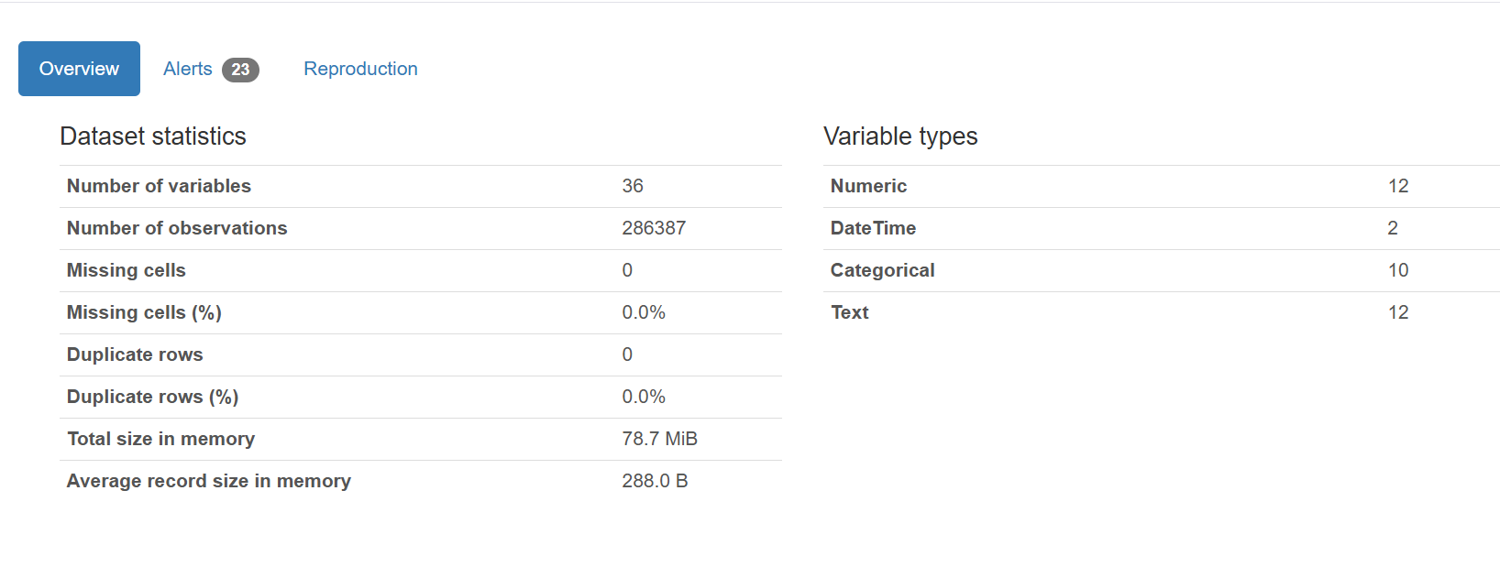
Overview

Slide 5
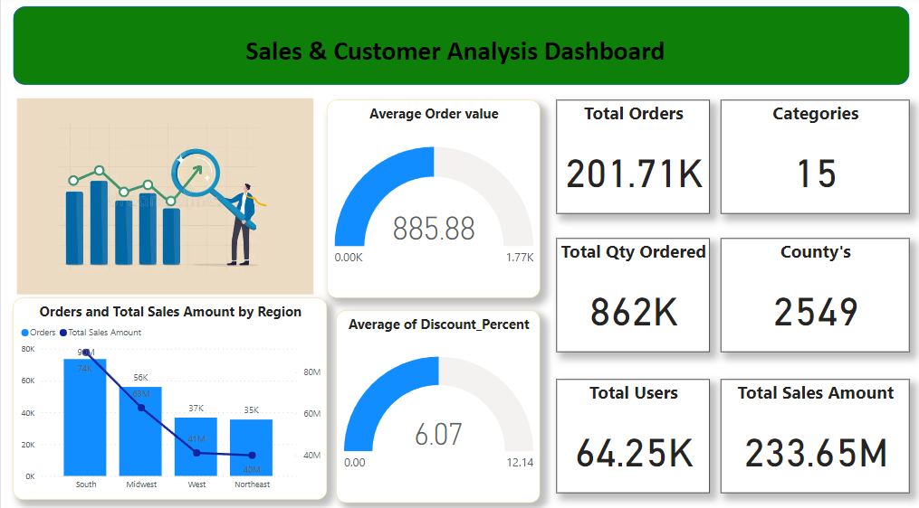
Data Visualization

Slide 6
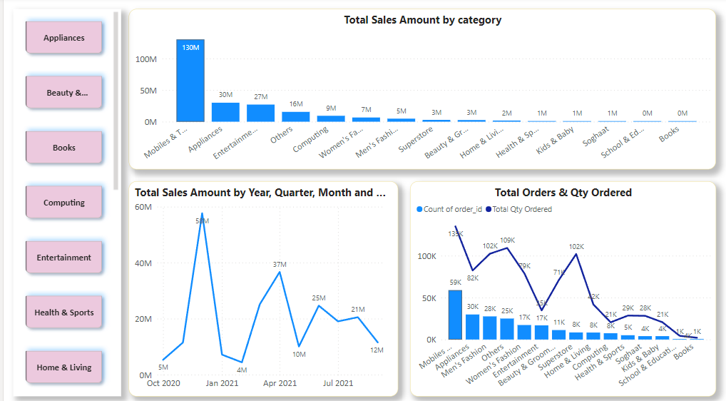
Products Analysis Dashboard

Slide 7
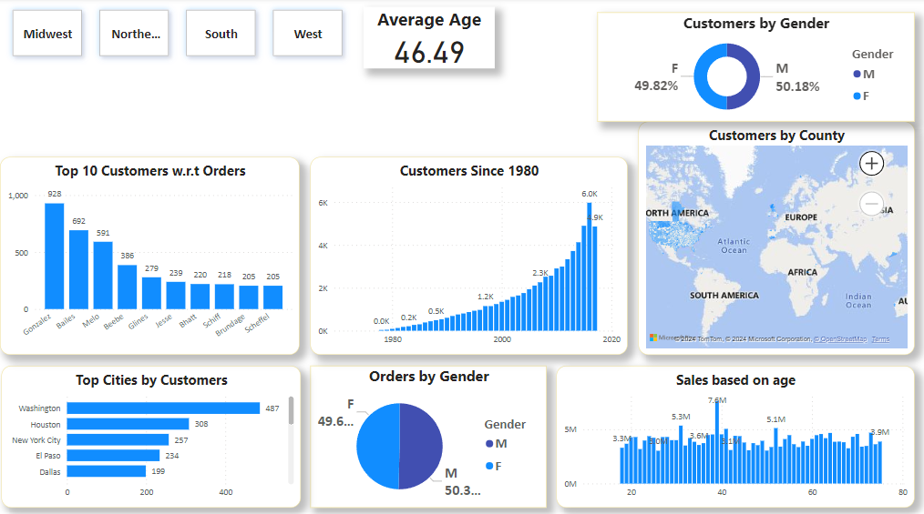
Customers Analysis

Slide 8
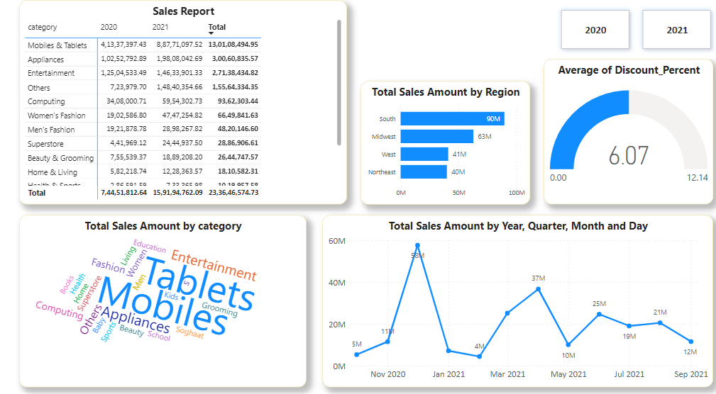
Sales Analysis Dashboard

Slide 9
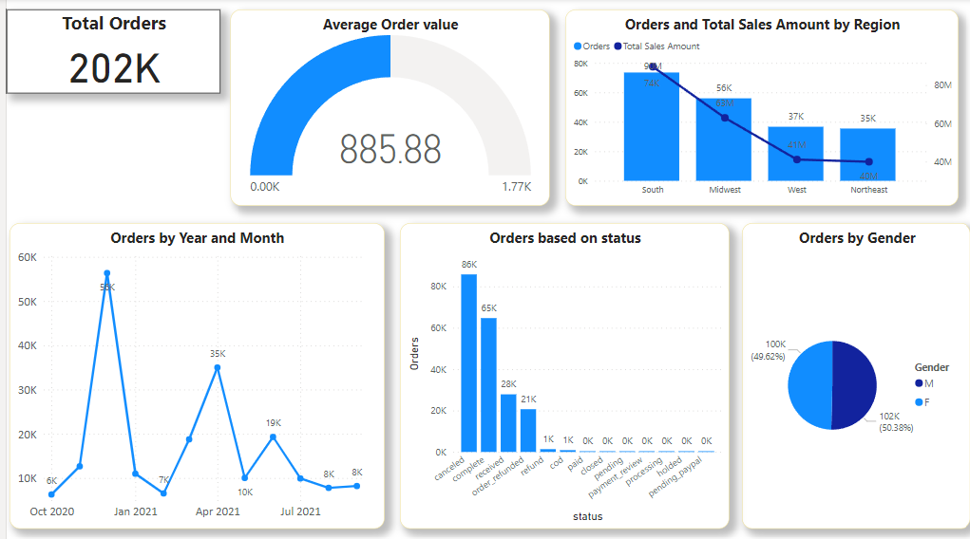
Orders Analysis

Slide 10
Insights
The Total Sales Amount varied from 30,21,285.63 to 76,04,190.56 across the 58 age categories.
The overall sales amount increased by 117.59% between Wednesday, September 1, 2021, and Thursday, October 1, 2020, as a result of an upward trend in sales.
Books had the lowest number of orders (708), while Mobiles & Tablets had the highest count of orders (58,832), 8,209.60% higher than books.
15.66% of the total quantity ordered was made up of phones and tablets.
With 90M, South Region had the largest total sales amount, followed by the Midwest, West, and Northeast regions. Of the total sales amount, 38.37% came from the South.
The south region has the largest client base and men make up the majority of both customers and orders overall.
﻿At 73520, South had the highest Orders and was 107.14% higher than Northeast, which had the lowest Orders at 35493.
During its sharpest downturn, orders fell from 18750 to 8194 between March 2021 and September 2021.
Beginning in March 2021, orders declined by 56.30% (10556) over the course of six months.
The range of Orders over all 13 statuses was 3 to 85817.
Between October 2020 and September 2021, orders increased by 30.39% as a result of an upward trend.

Slide 11
Business Recomendations
Boost Sales in Underperforming Regions
The South region leads in sales, while the Northeast lags. Consider regional marketing campaigns and promotions in underperforming areas to balance revenue.
Diversify Product Sales
Since Mobiles & Tablets dominate sales, introduce bundled offers (e.g., discounted accessories with phone purchases) and explore ways to increase book sales (e.g., limited-time discounts or membership perks).
Customer Retention During Downturns
Orders dropped significantly between March and September 2021.
Implement seasonal discounts, loyalty programs, or referral incentives during expected downturns to maintain order volume.
Optimize Marketing for Target Demographics
The South region has the largest customer base, dominated by male customers.
Use personalized marketing and advertisements tailored to gender-based preferences for better engagement.
Manage Inventory Efficiently
With significant order fluctuations, optimize supply chain logistics to ensure high-demand products are stocked sufficiently while minimizing surplus inventory.
Increase High-Value Customer Engagement
Customers making high-value purchases should receive exclusive offers, VIP memberships, or enhanced customer service to improve retention and lifetime value.

Slide 12


